Slide 1
OCG 350
Presentation hints for Nov 27
Nov 2018 OCG 350

Slide 2
A maximum of four slides:
1) What data are you trying to match or
simulate?
2) What model structure did you use?
which parameters did you make time
dependent?
3) How close did you get to modeling the
observed data?
4) What are the next steps?
Nov 2018 OCG 350

Slide 3
Presentations:
You will introduce yourselves:
Include whether you are a rising junior or senior, your major, and the title of your talk.
Each student will be responsible for one or two slides
Questions:
Other students will go first, then the rest of the audience
Evaluation/constructive critique afterwards
Nov 2018 OCG 350

Slide 4
General elements of a successful presentation

Slide 5
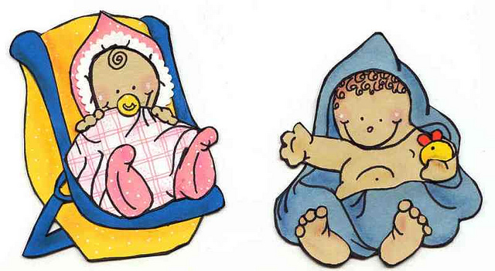





Who is your audience?
Nov 2018 OCG 350
Notes:
What do they need to learn?
Why should they listen?
What do they already know that you do not need to repeat?

Slide 6
- What do they need to learn?
- Why should they listen?
- What do they already know that you do not need to repeat?
Nov 2018 OCG 350

Slide 7
2) What is your central message?
Think: If you only had one sentence…
Nov 2018 OCG 350
Notes:
If you had only one sentence

Slide 8
Ahead of time:
i) Prepare an outline of your presentation
ii) Identify a few key points
iii) Prepare to start and end strongly
- Interesting opening point (‘hook’, ‘lead’)
- What is the problem?
http://www.mindtools.com/pages/article/newCS_96.htm
Notes:
Lead: challenging question, amazing fact, interesting title

Slide 9
Ahead of time:
i) Prepare an outline of your presentation
ii) Identify a few key points
iii) Start and end strongly
- Interesting opening point (‘hook’, ‘lead’)
- What is the problem?
Challenging question?
Title Interesting
http://www.mindtools.com/pages/article/newCS_96.htm
Notes:
Lead: challenging question, amazing fact, interesting title

Slide 10
In thinking your outline:
Logical or chronological progression?
Or
Conclusion first? Progress backwards?

Slide 11
Speak clearly and loud enough
Look at your audience

Slide 12
Visual aids:
- Clarify your spoken words
- Keep them simple
- Keep them professional looking
Nov 2018 OCG 350
Notes:
Audience’s attention drawn from speaker to screen, so support and clarify your spoken words
Dark room is invitation to doze!

Slide 13
‘Rules’ for good visuals:
1) Must help your talk
Ask 3 questions: - Will it add to my presentation?
- Does it relate my spoken word?
- Is the graphic quality sufficient?
Nov 2018 OCG 350

Slide 14
‘Rules’ for good visuals:
1) Must help your talk
Ask 3 questions: - Will it add to my presentation?
- Does it relate my spoken word?
- Is the graphic quality sufficient?
2) Be brief and concise
Nov 2018 OCG 350

Slide 15
‘Rules’ for good visuals:
1) Must help your talk
Ask 3 questions: - Will it add to my presentation?
- Does it relate my spoken word?
- Is the graphic quality sufficient?
2) Be brief and concise
3) Legible and clearly visible to all

Slide 16
‘Rules’ for good visuals:
1) Must help your talk
Ask 3 questions: - Will it add to my presentation?
- Does it relate my spoken word?
- Is the graphic quality sufficient?
2) Be brief and concise
3) Legible and clearly visible to all
4) Limit the # of information points per slide
Nov 2018 OCG 350

Slide 17
‘Rules’ for good visuals:
1) Must help your talk
Ask 3 questions: - Will it add to my presentation?
- Does it relate my spoken word?
- Is the graphic quality sufficient?
2) Be brief and concise
3) Legible and clearly visible to all
4) Limit the # of information points per slide
5) Limit the # of visuals
Nov 2018 OCG 350

Slide 18
‘Rules’ for good visuals:
1) Must help your talk
Ask 3 questions: - Will it add to my presentation?
- Does it relate my spoken word?
- Is the graphic quality sufficient?
2) Be brief and concise
3) Legible and clearly visible to all
4) Limit the # of information points per slide
5) Limit the # of visuals
6) Use color for emphasis
Nov 2018 OCG 350
Notes:
For visual impact, do not get carried away

Slide 19
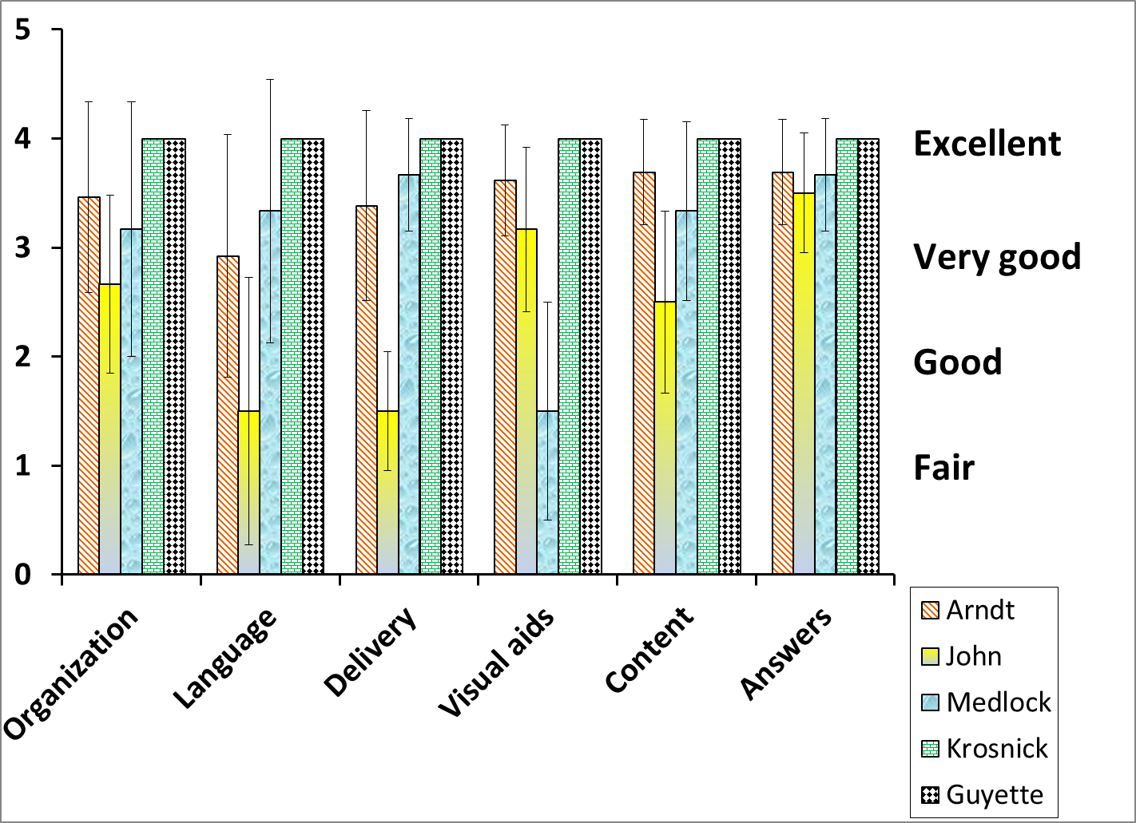
Don’t get carried away!
Because you can do it does not mean you should!
Notes:
Because you can do it does not mean you should!

Slide 20
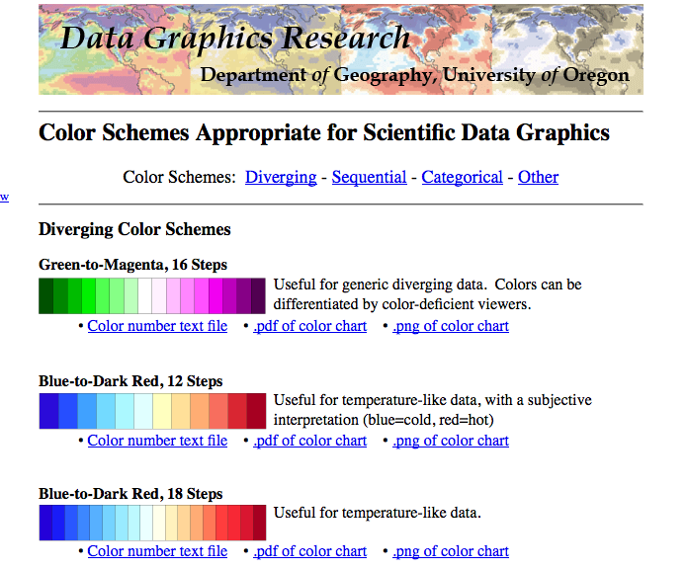
Another source with eye toward colorblind safe colors
http://geog.uoregon.edu/datagraphics/color_scales.htm

Slide 21
2) What is your central message?
Colorful slides? Great!
but don’t forget what is important is the central message
Nov 2018 OCG 350
Notes:
Great colorful slides but don’t forget what is important is the central message

Slide 22
“I keep six honest serving men
(They taught me all I knew);
Their names are What and Why and When
And How and Where and Who.”
Rudyard Kipling
Were you thorough? Did you get to the what, why,…
Nov 2018 OCG 350
Notes:
Were you thorough? Did you get to the what, why,…

Slide 23
Practice practice practice
practice practice practice
Check your timing
Nov 2018 OCG 350
Notes:
No need to memorize, but practice

Slide 24
Nervous about questions? A few tips…
Use physical relaxation, deep breathing
Visualize yourself giving a great presentation
Practice practice
Nov 2018 OCG 350
Notes:
Use physical relaxation, deep breathing
Visualize yourself giving a great presentation
Practice practice

